Slide 1
Ecommerce Business Analytics
Aditya Thakur
(682)802-8888
Aditya.thakur@utdallas.edu
Zuri Furniture assignment

Slide 2
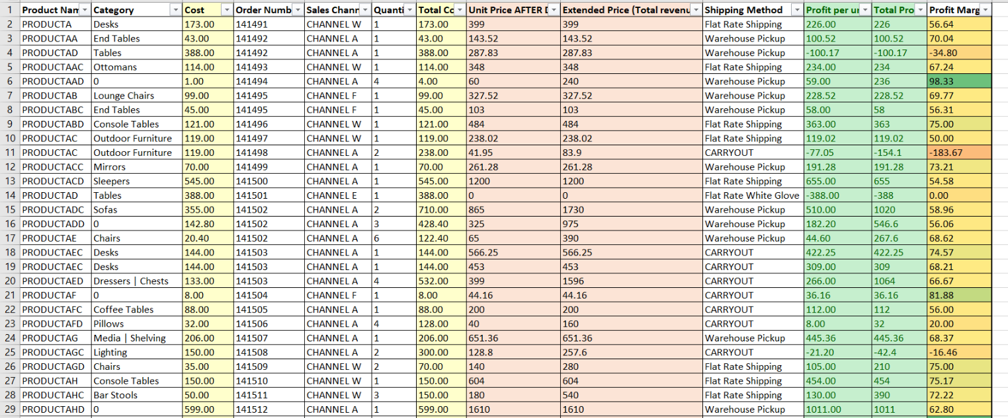
First step involved me merging the two table and calculating the additional fields that will help me with the analysis going forward

Slide 3
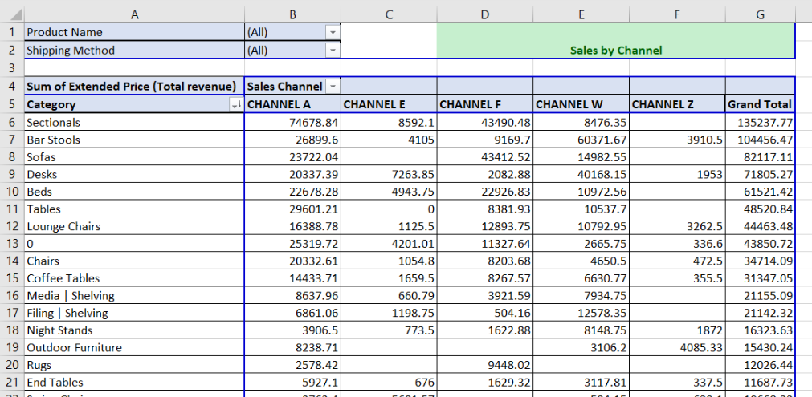
Here we analyze our sales across different channels and identify which platform works for a particular category. We can use the Product/Shipping Method filters to modify our analysis as per the requirement

Slide 4
In this case, we identify our profitability by sales channel in terms of individual products as well as overall
Category | (All) |  | Profitability by Channel (per unit value)
Shipping Method | (All)
Sum of Profit per unit | Sales Channel
Product Name | CHANNEL A | CHANNEL E | CHANNEL F | CHANNEL W | CHANNEL Z | Grand Total
PRODUCTA |  |  |  | 452 |  | 452
PRODUCTAA | 100.52 |  |  |  |  | 100.52
PRODUCTAAC |  | 278 |  | 234 |  | 512
PRODUCTAAD | 730 |  |  |  |  | 730
PRODUCTAB | 301.5 |  | 685.56 | 279.25 |  | 1266.31
PRODUCTABC | 189.57 |  | 242.28 | 66.87 |  | 498.72
PRODUCTABD | 687.28 |  |  | 2359.5 |  | 3046.78
PRODUCTAC | -77.05 |  |  | 119.02 |  | 41.97
PRODUCTACC | 440.78 |  |  |  |  | 440.78
PRODUCTACD | 655 |  |  |  |  | 655
PRODUCTAD | -100.17 | -388 |  |  |  | -488.17
PRODUCTADC | 510 |  |  | 1242.5 |  | 1752.5
Row Labels | Sum of Extended Price (Total revenue) | Sum of Total Cost | Sum of Profit per unit | Profitability %
CHANNEL A | 352,440.26 | 118,549.66 | 200,370.25 | 56.85
CHANNEL E | 45,005.62 | 15,588.90 | 23,566.64 | 52.36
CHANNEL F | 199,161.77 | 67,366.00 | 122,567.61 | 61.54
CHANNEL W | 228,971.83 | 60,551.43 | 127,232.67 | 55.57
CHANNEL Z | 17,469.53 | 4,882.74 | 10,892.29 | 62.35
Grand Total | 843,049.01 | 266,938.73 | 484,629.46 | 57.49

Slide 5
The worksheets below help us identify our best sold products in terms of profit margin per product as well as products that have caused the most profit
 |  |  | Best item sold in terms of Proft Margin %
Average of Profit Margin | Column Labels
Row Labels | CHANNEL A | CHANNEL E | CHANNEL F | CHANNEL W | CHANNEL Z | Grand Total
PRODUCTKC | 100 |  |  |  |  | 100.00
PRODUCTDA | 100 |  |  |  |  | 100.00
PRODUCTCZ | 100 |  |  |  |  | 100.00
PRODUCTAT | 100 |  | 100 |  |  | 100.00
PRODUCTTD |  |  |  |  | 100 | 100.00
PRODUCTAWC |  |  | 100 | 100 |  | 100.00
PRODUCTCE |  |  |  | 100 |  | 100.00
PRODUCTAAD | 99.0922619 |  |  |  |  | 99.09
PRODUCTAV | 90.06557377 |  |  |  |  | 90.07
PRODUCTCI |  |  |  | 86.51047213 |  | 86.51
 |  |  | Best item sold in terms of Total Profit
Sum of Total Profit | Column Labels
Row Labels | CHANNEL A | CHANNEL E | CHANNEL F | CHANNEL W | CHANNEL Z | Grand Total
PRODUCTAHC | 5352.41 | 306 | 346.8 | 12931.25 | 152.5 | 19088.96
PRODUCTBN | 4336.32 | 1006.5 | 774.44 | 9058.5 | 1006.5 | 16182.26
PRODUCTCC | 2691.1 |  | 6250.7 | 3213.55 |  | 12155.35
PRODUCTBM | 1822.12 |  | 9110.6 |  |  | 10932.72
PRODUCTASC | 3884.16 | 882 | 1954.98 | 3399 | 345 | 10465.14
PRODUCTBQC | 1569.4 | 2065.5 | 6773.7 |  |  | 10408.6
PRODUCTAY | 809.2 |  |  | 8921.5 |  | 9730.7
PRODUCTFO | 7753.1 |  |  |  |  | 7753.1
PRODUCTFAC | 2036 | 928 | 2507.28 | 2050 |  | 7521.28
PRODUCTBHD | 774.44 | 865 | 774.44 | 5032.5 |  | 7446.38

Slide 6
The following table gives us the quantities of product sold in a category via a certain shipping method
Category vs Shipping Method quantities
Sum of Quantity | Column Labels
Row Labels | CARRYOUT | Delivery | Extended Area TBD | FedEx GroundÂ® | Flat Rate Shipping | Flat Rate White Glove | LTL White Glove | Store Pickup | UPS 3 Day Select | UPS Ground | Warehouse Pickup | (blank) | Grand Total
0 | 30 | 61 |  |  | 2 | 15 |  | 13 |  | 1 | 40 |  | 162
Art | 3 | 2 |  |  |  |  |  | 1 |  |  | 4 |  | 10
Bar Stools | 14 | 43 |  |  | 295 | 6 |  | 39 | 2 | 19 | 100 |  | 518
Bars |  | 2 |  |  | 12 |  |  |  |  |  | 2 |  | 16
Beds | 1 | 33 |  |  | 6 | 2 |  |  |  |  | 7 |  | 49
Benches | 1 |  |  |  | 1 |  |  |  |  |  | 1 |  | 3
Buffets | Storage |  | 3 |  |  | 1 |  |  |  |  |  |  |  | 4

Slide 7
Thank you for the opportunity to analyze the dataset
Please refer to the Excel sheet attached alongwith the mail for a detailed report
Main functions used – Vlookup, Pivot and Conditional Formatting

